Slide 1
Oxidation of methylated amines
(CH₃ )₄N⁺
(CH₃ )₃N
(CH₃ )₂NH
CH₃NH₂
NH₃
HCHO
Tetramethylammonium Trimethylamine Dimethylamine Methylamine Ammonia Formaldehyde
Metabolism involves demethylation which always occurs at the same time as an oxidation. One methyl group is removed at a time, the C1 unit being removed as formaldehyde.
Methylated amines in the marine environment: Quote from Yin Chen,¹ Nisha A. Patel, Andrew Crombie, James H. Scrivens, and J. Colin Murrell¹
Methylated amine compounds, including TMA, are ubiquitous in the environment—for example, as end products of protein putrefaction (18). In the marine environment, methylated amines are released as a result of degradation of quaternary amine osmoregulators, such as glycine betaine, which are used by marine organisms to counteract water stress (19–21). Once released into the environment, methylated amines can be used by microorganisms as a C or N source. In fact, in the oceans, methylated amines represent a significant pool of C and N, and standing concentrations up to hundreds of nanomolar and micromolar have been reported in the water column (22, 23) and sediment pore water (24, 25), respectively. In addition to being involved in biogeochemical cycles of C and N, recent studies also suggest that methylated amines have the potential to affect global climate, being precursors of aerosol formation in the upper atmosphere (26–28

Slide 2
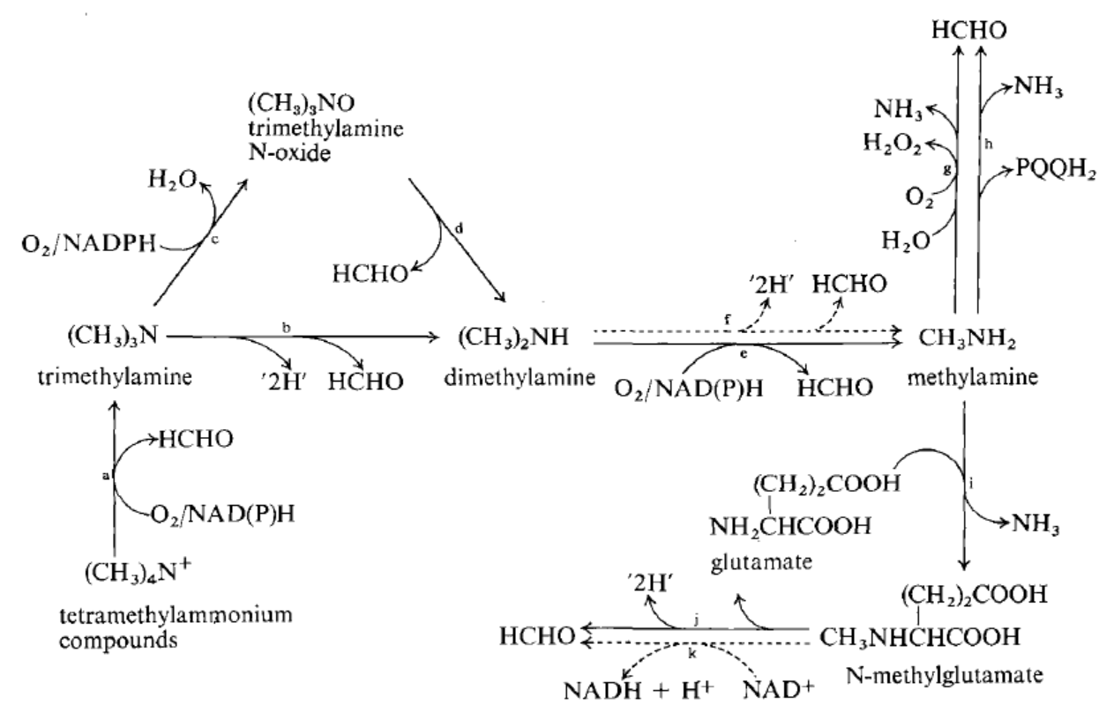
Oxidation of methylated amines
(a) Tetramethylammonium monooxygenase; (b) trimethylamine dehydrogenase (in obligate methylotrophs); (c) trimethylamine monooxygenase (in facultative methylotrophs); (d) trimethylamine TV-oxide demethylase (aldolase); (e) dimethylamine monooxygenase (all methylotrophs); (f) dimethylamine dehydrogenase
(anaerobic Hyphomicrobia); (g) amine oxidase (in Arthrobacter and methazotrophic yeasts); (h) methylamine dehydrogenase; (i) N-methylglutamate synthase; (j) and (k) N-methylglutamate dehydrogenases.

Slide 3
Bacterial oxidation of methylated amines
Much of the earlier work on this was done by Bob Eady in the lab of Peter Large in Hull in Pseudomonas AM1 (now Methylobacterium extorquens AM1) which was first isolated on methylamine (AM1 means Airborne Methylamine 1). 1968 -
He showed that oxidation is catalysed by a dye-linked methylamine dehydrogenase, assayed in a reaction system like methanol dehydrogenase.
CH₃NH₂ + A + H₂O
The prosthetic group of methylamine dehydrogenase is TTQ, tryptophan tryptophyl quinone [McIntire et al 1991]. It is covalently bound, being a modified part of the protein backbone.
NH₃ + AH₂ + HCHO
Remarkable fact: the first 2 types of quinoprotein to be described were both isolated in Methylobacterium extorquens AM1.
The electron acceptor for methylamine dehydrogenase was shown in 1981 by Tobari and Harada to be a blue copper protein called Amicyanin. This is a single electron acceptor.

Slide 4
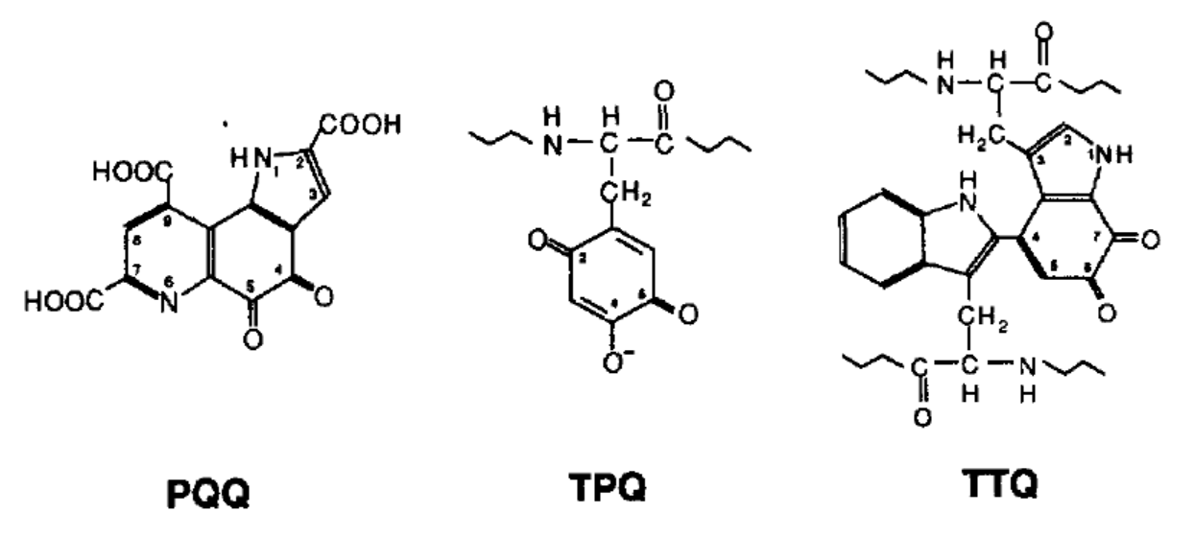
The prosthetic groups of some Quinoproteins
The prosthetic group of methanol dehydrogenase is PQQ, Pyrrolo-quinoline quinone [Kennard’s group 1979]
The prosthetic group of methylamine dehydrogenase is TTQ, tryptophan tryptophyl quinone [McIntire et al 1991
The prosthetic group of the copper containing amine oxidases is TPQ, topa-quinone [Klinman’s group 1990]

Slide 5
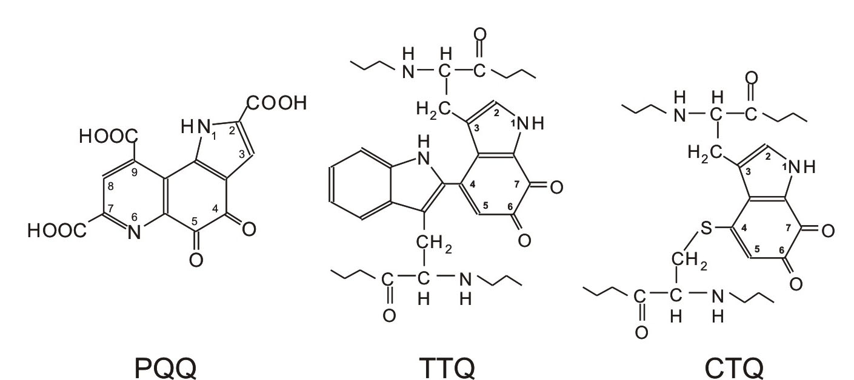
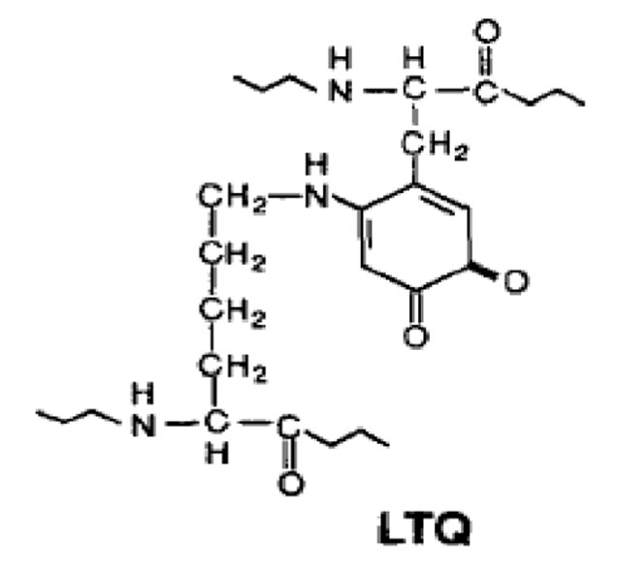
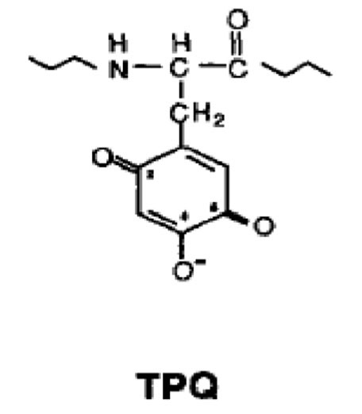
Prosthetic groups of quinoproteins
Dehydrogenases
PQQ
Not covalently bound
Oxidases
[Derived from tryptophan]
PQQ, pyrroloquinoline quinone
TTQ, Tryptophan tryptophylquinone
CTQ, cysteine tryptophylquinone
TPQ, Topaquinone
LTQ, Lysine tyrosylquinone
[derived from tyrosine]

Slide 6
Electron transport during methylamine oxidation
NADH
2H⁺ + ½ O₂
H₂O
NADH
dehydrogenase
Oxidase
Cyt bc₁
complex
UQ
Periplasm
HCHO + NH₃
Cyt c_{H}
MeNDH
CH₃NH₂
2H⁺
Azurin
Amicyanin
Outer wall
1985 - 1990
Ashley Lawton and Kevin Auton
[Amicyanin – Tobari]
Bob Eady & Peter Large [MeNDH; 1968-1971]

Slide 7

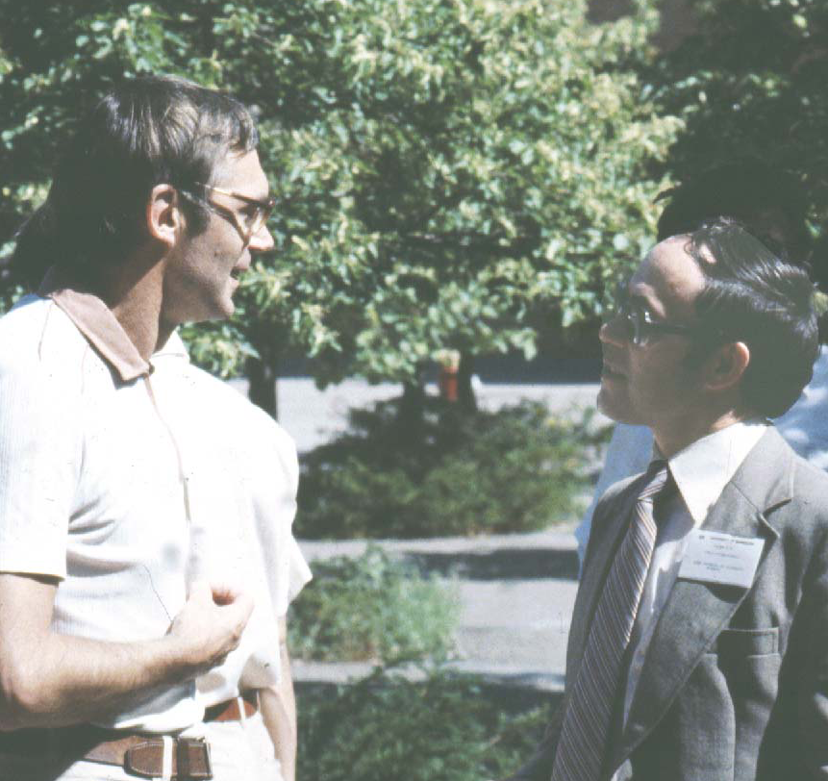


Methylamine dehydrogenase [Bob Eady and Peter Large, 1968-1971]
Bob
Peter
Yuri
Trotsenko
Peter
Electron transport chain
[Ashley Lawton &
Kevin Auton, 1983-1989]
Kevin Auton
Founder and CEO
of NextGen
Ashley Lawton
President, Phylos Inc.

Slide 8
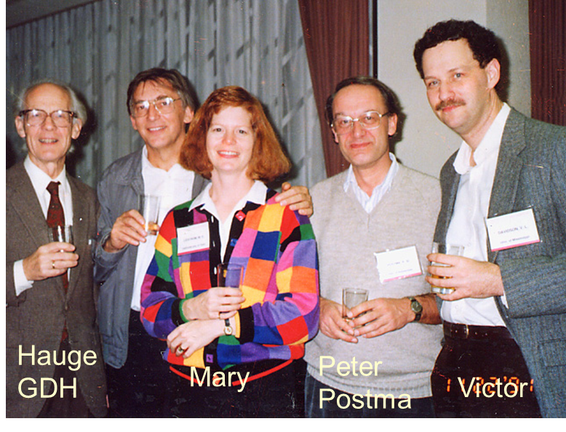
Much of the subsequent study of the mechanism of methylamine dehydrogenase has been done by Victor Davidson and the genetics in Mary Lidstrom’s group (with Mila Chistaserdova)

Slide 9
Other amine oxidising enzymes
Methylamine oxidase (Amine oxidase) In Arthrobacter P1
CH₃NH₂ + O₂ + H₂O HCHO + NH₃ + H₂O₂
The peroxide is removed by catalase. No useable energy from this reaction.
Its prosthetic group is probably TPQ as in other copper-containing amine oxidases.
Systems involving methylated amino acids
In ‘non-pigmented pseudomonads’: Ps. aminovorans; Pseudomonas MA, & Hyphomicrobium
Two step system
Methylamine + glutamate N-methylglutamate + ammonia (synthase)
N-methylglutamate + PMS + H₂O glutamate + PMSH₂ + HCHO (dehydrogenase)
The dehydrogenase is usually a flavoprotein that interacts like other flavoproteins with the electron transport chain at the level of ubiquinone and cytochrome b.
(There are some reports of NAD-linked dehydrogenases in some Pseudomonas and Hyphomicrobia Netrusov)
The next slide shows some alternative two-part systems

Slide 10
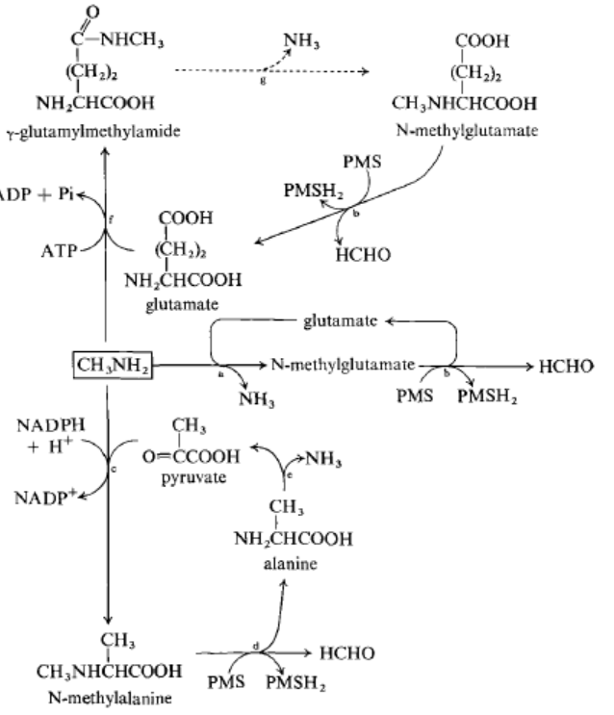
Some alternative two-part systems
Alternative systems for production of N-methylglutamate are in Pseudomonas MS and Hyphomicrobium but they may not be involved in growth. Kung & Wagner, Loginova & Trotsenko, Meiberg & Harder

Slide 11
Oxidation of tetramethylammonium salts to trimethylamine and formaldehyde In Organism 5H2. Hampton & Zatman 1973. A non-pigmented Gram-negative, non-motile facultative methylotroph. No energy is available from this reaction
Mono-oxygenase
Tetramethylammonia + O₂ + NADH trimethylamine + HCHO + H₂O
Oxidation of trimethylamine to dimethylamine and formaldehyde
In obligate methylotrophs; organism W3A1, & 4B6 (like Methylophilus), and Hyphomicrobium Colby & Zatman 1973, 1974
Trimethylamine dehydrogenase
(CH₃)₃N + PMS + H₂O (CH₃)₂NH + HCHO + PMSH₂
The enzyme is an unusual flavoprotein, interacting with the electron transport chain by way of a second flavoprotein, cytochrome b etc. So provides energy

Slide 12
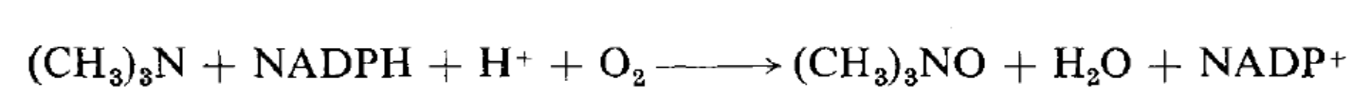
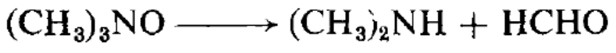
Indirect route for trimethylamine oxidation
A trimethylamine mono-oxygenase produces the N-oxide which is then demethylated to formaldehyde plus dimethylamine. During growth on trimethylamine. In Pseudomonas aminovorans (a typical Pseudomonas sp.) and Bacillus PM6. Boulton & Large; Myers and Zatman.
a) Trimethylamine mono-oxygenase. No energy available
b) Trimethylamine N-oxide demethylase No energy available
It is the 2nd enzyme for oxidation of trimethylamine and also the 1st enzyme for growth of Bacillus PM6 on trimethylamine N-oxide

Slide 13
The oxidation of dimethylamine to methylamine and formaldehyde
There are two types of enzyme; the same one operates when dimethylamine is a growth substrate as when it is an intermediate in the oxidation of higher methylated amines.
Dimethylamine mono-oxygenase No energy is available from this reaction
In Pseudomonas aminovorans (a typical pseudomonad). Bob Eady and Peter Large.
Also in Hyphomicrobium in aerobic conditions
(CH₃)₂NH + NAD(P)H + H⁺ + O₂ CH₃NH₂ + HCHO + NAD(P)⁺ + H₂O
Dimethylamine dehydrogenase Energy is available. Meiberg and Harder 1978.
In Hyphomicrobium during anaerobic growth with nitrate as electron acceptor.
(CH₃)₂NH + PMS + H₂O CH₃NH₂ + HCHO + PMSH₂
Similar to trimethylamine dehydrogenase. An unusual flavoprotein that interacts with electron transport chain before cytochrome b.

Slide 14
Oxidation of methylated amines
(a) Tetramethylammonium monooxygenase; (b) trimethylamine dehydrogenase (in obligate methylotrophs); (c) trimethylamine monooxygenase (in facultative methylotrophs); (d) trimethylamine TV-oxide demethylase (aldolase); (e) dimethylamine monooxygenase (all methylotrophs); (f) dimethylamine dehydrogenase
(anaerobic Hyphomicrobia); (g) amine oxidase (in Arthrobacter and methazotrophic yeasts); (h) methylamine dehydrogenase; (i) N-methylglutamate synthase; (j) and (k) N-methylglutamate dehydrogenases.

Slide 15
Distribution of routes for oxidation of methylated amines
Trimethylamine
NAD-independent TMN dehydrogenase: Obligate methylotrophs (eg Methylophilus) and Hyphomicrobium
Mono-oxygenase system: All other methylotrophs including Bacillus
Dimethylamine
Mono-oxygenase: All aerobic methylotrophs including Hyphomicrobium growing aerobically
Dimethylamine dehydrogenase: Hyphomicrobium growing anaerobically
Methylamine
There are three types of system.
Methylamine dehydrogenase (MD); Methylamine oxidase (MO); N-methylglutamate-linked (NMG)
Most obligate methylotrophs MD
Facultative autotrophs MD
Pink facultative methylotrophs MD or NAD-dependent or NAD-independent NMG dehydrogenase
Non-pigmented pseudomonads NAD-independent NMG dehydrogenase
Hyphomicrobia NAD-dependent or NAD-independent NMG dehydrogenase
Arthrobacter and yeasts MO
NOTE: Some bacteria may have more than one system but this has rarely been tested.
There is no correlation between the system for methyamine oxidation and assimilation pathway

